Slide 1
SA300 Crop Science and Horticulture
By Mubika Demian,
M.Sc. Agronomy/Integrated Plant Protection.

Slide 2
Students learning objectives
Understand plant science and its major principles to ensure optimal yield, quality and sustainability.
Identify common field crops and their uses.
Define Horticultural crops and understand their uses.
Describe crop physiology and morphology.

Slide 3
MAJOR TYPES OF CROPS
Crops can be classified into several categories:
1. Food crops – maize, rice, wheat, cassava, sorghum
2. Cash crops – cotton, tobacco, coffee, tea
3. Horticultural crops – vegetables, fruits, flowers
4. Industrial crops – sugarcane, oil palm, sunflower
5. Forage crops – pasture grasses and legumes Each category plays a unique role in human welfare and economic development.

Slide 4
cLASSIFICATION OF CROPS
Origin
Indigenous crops: These are crops that are native to a particular region or country. E.g., cassava, okra, plantain, millet and sorghum.
Exotic crops: Exotic crops, also known as introduced or non-native crops, are those that are not naturally found in a particular region but have been introduced from other regions or countries. E.g., cabbage, carrot, lettuce, apples and cashews.

Slide 5
cLASSIFICATION OF CROPS
Growth Cycle
Annual crops: Annual crops complete their full life cycle within a year. eg maize (corn), wheat, rice, soya beans and most vegetables.
Biennial crops: Biennial crops have a life cycle that spans two (2) years. Eg carrots, beets, onions, and some types of cabbage and okra.
Perennial crops: Perennial crops have a life cycle of more than two (2) years. Eg cocoa, citrus cashew, mango, avocado, cola, coffee and some forage grasses.

Slide 6
cLASSIFICATION OF CROPS
Botanical Classification
Poaceae (grasses): Crops such as wheat, rice, corn, barley and oats belong to the grass family.
b. Solanaceae (nightshades): Crops like tomatoes, potatoes, peppers and eggplants belong to this family.
c. Leguminosae/Fabaceae (legumes): Leguminous crops include beans, peas, lentils, soya beans, and peanuts.
Rosaceae (rose family): Fruits like apples, pears, cherries and strawberries belong to this family.

Slide 7
Introduction to Crop production
Crop production is a branch of agricultural science that focuses on the principles and practices involved in growing crops for food, fiber, fuel, and other economic uses. It is regarded as a scientific discipline because it applies systematic knowledge, research methods, and technological innovations to improve the productivity and sustainability of farming systems.
As a scientific field, crop production integrates knowledge from various disciplines such as agronomy, soil science, plant physiology, plant breeding, entomology, plant pathology, and agricultural economics. These fields work together to provide a holistic understanding of how crops grow, develop, and respond to different environmental and management conditions.

Slide 8
Crop production as a science and business.
Crop production is a multifaceted endeavor that combines the art, science, and business of cultivating crops.
As an art, it involves the skillful performance of farm operations, while as a science, it applies scientific principles to maximize crop yield and profitability.
As a business, it aims at generating a net return through the management of land, labor, water, and capital, employing various scientific knowledge for the production of food, feed, fiber, and fuel. In recent years, agriculture has been commercialized to run as a business through mechanization, focusing on maximizing output relative to inputs and producing at times of high demand and prices.

Slide 9
Crop production as a business.
Agronomy – From the Greek word “agros” meaning field and “nomos” meaning to manage. Thus, Agronomy deals with the principles and practices of managing field crops and soils.
Horticulture - From the Latin words “hortus”, which means a garden (a term derived from Anglo-saxon word “gyrdan” which means to enclose), Horticulture is the branch of agriculture that deals with intensive cultivation of fruits, vegetables, flowers, ornamental plants, and landscape design.

Slide 10
Scope of crop science
1. Crop Production and Management – Principles of crop growth, land preparation, planting methods, fertilizer management, irrigation, pest and disease control, and post-harvest handling.
2. Agronomy – Study of soil–plant relationships, cropping systems, conservation agriculture, and sustainable farming systems.
3. Plant Breeding and Genetics – Development of improved crop varieties with higher yield, drought tolerance, and pest resistance.
4. Soil Science – Soil fertility, soil conservation, soil chemistry, and fertilizer use.
5. Crop Protection – Entomology, plant pathology, weed science, and integrated pest management.
6. Agricultural Biotechnology – Genetic engineering, tissue culture, and modern breeding technologies.
7. Research and Extension – Field experimentation, data analysis, and farmer advisory services.

Slide 11
The Importance of Crop Production
Economic importance: Crops contribute to national and global economies by generating income and employment opportunities.
Livelihoods and rural development: Crops are a lifeline for many rural communities, especially in developing countries.
Environmental benefits: Certain crops, such as legumes, help improve soil fertility through nitrogen fixation and reducing the need for synthetic fertilisers.
Trade and global exchange: Crops are traded globally, fostering international relations and exchange.
Industrial and commercial uses: Many crops serve as raw materials for various industries such as textiles, pharmaceuticals, biofuels, cosmetics and construction.
Food security: Crops are the primary source of food for humans and animals.

Slide 12
The Importance of Crop Production
1. SOURCE OF FOOD - All staple foods consumed in Zambia and around the world such as maize meal, rice, potatoes, and vegetables come from crop farming.
2. EMPLOYMENT CREATION - Agriculture is one of the largest employers in many developing countries, many are employed directly as farmers, farm workers, extension officers, researchers, and agribusiness operators.
3. SOURCE OF RAW MATERIALS FOR INDUSTRIES - Many industries depend on crop products as raw materials. Examples include:
Cotton for textile industries
Sugarcane for sugar processing
Tobacco for cigarette manufacturing
Sunflower and soybean for cooking oil Without crop production,
agro-based industries would collapse, leading to economic decline.

Slide 13
The Importance of Crop Production
4. CONTRIBUTION TO NATIONAL ECONOMY - Agriculture contributes significantly to Gross Domestic Product (GDP) in many African countries. Revenue from crop production supports government budgets through taxes and export earnings. A strong crop production sector stimulates growth in other sectors such as manufacturing, trade, and transport.
4. RURAL DEVELOPMENT - Most farming activities take place in rural areas. Investment in crop production leads to the development of rural infrastructure such as roads, storage facilities, irrigation schemes, and markets. This improves the quality of life in rural communities.
6. FOOD SECURITY AND NATIONAL STABILITY - A country that is able to produce enough food for its people enjoys social and political stability. Shortage of food often leads to high prices, hunger, and social unrest. Therefore, strong crop production systems are important for national peace and security.

Slide 14
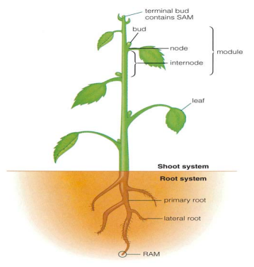
Shoot system: stem, leaves, buds, and flowers
The shoot system refers to the above-ground part of a plant and is responsible for photosynthesis, reproduction, support, and transport of materials. It develops from the plumule of the embryo and consists of the stem, leaves, buds, and flowers.
1. Stem - The stem is the main supporting axis of the plant shoot system.
Functions of the Stem
Supports leaves, flowers, and fruits.
Conducts water and minerals from roots to leaves (xylem).
Transports manufactured food to other plant parts (phloem).
Stores food and performs photosynthesis in some plants.
Structural Features
Nodes – points where leaves and buds arise.
Internodes – regions between nodes.
May be herbaceous or woody.

Slide 15
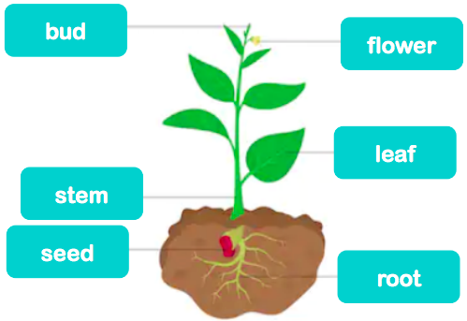
2. Leaves - Leaves are flat, green organs attached to the stem at nodes and are the primary sites of photosynthesis.
Functions of Leaves
Photosynthesis
Transpiration
Gaseous exchange
Storage in some plants
Parts of a Leaf
Leaf base
Petiole
Lamina (leaf blade)
3. Buds - Buds are undeveloped or embryonic shoots that give rise to new branches or flowers. Types of Buds
Apical buds – responsible for increase in length
Axillary buds – form branches or flowers
Adventitious buds – arise from unusual positions

Slide 16
4. Flowers - are the reproductive structures of flowering plants and are involved in sexual reproduction.
Main Parts of a Flower
Calyx (sepals) – protection
Corolla (petals) – attraction of pollinators
Androecium (stamens) – male reproductive part
Gynoecium (pistil/carpel) – female reproductive part
Importance of the Shoot System
Essential for photosynthesis and food production.
Determines crop yield and productivity.
Important in agricultural practices such as pruning and pest control.

Slide 17
Root system: tap roots and fibrous roots
The root system is the underground part of a plant that plays a critical role in anchorage, absorption of water and mineral nutrients, storage of food, and synthesis of plant growth regulators. Based on their origin, structure, and growth pattern, root systems are broadly classified into two main types: the tap root system and the fibrous root system.
General Functions of Roots
Anchorage of the plant in the soil.
Absorption of water and mineral nutrients.
Storage of reserve food materials.
Conduction of absorbed materials to aerial parts.
Synthesis of plant hormones such as cytokinins and gibberellins.

Slide 18
Tap Root System
Tap Root System The tap root system develops from the radicle of the germinating seed. The radicle grows vertically downward into the soil to form a prominent primary root called the tap root. This main root gives rise to secondary (lateral) and tertiary roots.
Characteristics of Tap Root System.
Presence of a single, thick, primary root (tap root).
Lateral roots arise from the main root.
Deep penetration into the soil.
Strong anchorage to the plant.
Capable of accessing deep soil moisture.

Slide 19
Fibrous Root System
Fibrous Root System The fibrous root system develops when the radicle is short-lived and replaced by a large number of thin roots that arise from the base of the stem. These roots are almost equal in size and form a dense mat.
Characteristics of Fibrous Root System.
Absence of a dominant main root.
Numerous thin roots of similar size.
Shallow spread in the upper soil layers.
Less deep penetration compared to tap roots.
Efficient in quick absorption of surface water.

Slide 20
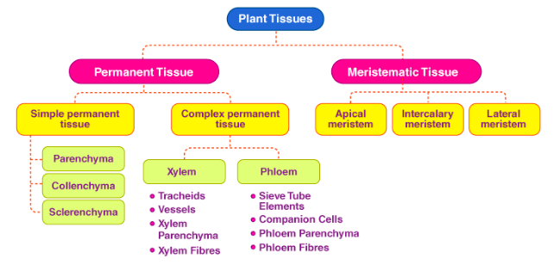
Plant Tissues
A tissue is a cluster of cells, that are alike in configuration and work together to attain a specific function. Different types of plant tissues include permanent and meristematic tissues.

Slide 21
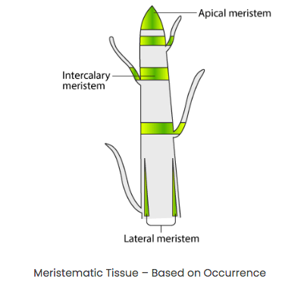
Meristematic Tissues
The main function of meristematic tissue is mitosis. The cells are small, thin-walled, with no central vacuole and no specialized features. Depending on the section where the meristematic tissues are existing, they are categorized as intercalary, lateral and apical meristems.
Apical meristem is existent at the growing tips or apical of stems and roots. Apical meristem upsurges the length of the plant.
Lateral meristem is existent in the radial portion of the stem or root. Lateral meristem upsurges the thickness of the plant.
Intercalary meristem is found at the internodes or at the base of the leaves. Intercalary meristem upsurges the size of the internode.

Slide 22
Permanent tissues
These cells have lost their ability to distribute but are specialised to offer elasticity, flexibility and strength to the plant. These tissues can be additionally categorised into:
Simple Permanent Tissue: They can be classified into sclerenchyma, collenchyma and parenchyma based on their purpose.
Complex Permanent Tissue: These tissues include phloem and xylem. Xylem is valuable for the transportation of water and solvable constituents. It is made up of xylem parenchyma, fibres, vessels and tracheids. Phloem is valuable in the transportation of food particles. Phloem consists of phloem parenchyma, phloem fibres, companion cells, sieve cells and sieve tubes.

Slide 23
Collenchyma, Sclerenchyma, Xylem, Phloem
Collenchyma - Their cell walls are made up of pectin and cellulose. Collenchyma is found in the marginal regions of leaves and stems and offers flexibility with the structural framework and mechanical support to plants.
Sclerenchyma - These are elongated, dead cells with lignin deposits in their cell wall. Sclerenchyma is found in the covering of seeds and nuts, around the vascular tissues in stems and the veins of leaves. Sclerenchyma provides strength to the plant.
Xylem - It helps in the transport of dissolved substances and water all through the plant. The diverse components of the xylem include vessels, tracheids, xylem fibres and xylem parenchyma. Xylem fibres and Tracheids are made up of lignin, which provides structural support to the plant.
Phloem - This tissue helps in the transportation of food all through the plant. The diverse elements of phloem include phloem fibres, sieve tubes, phloem parenchyma and companion cells.

Slide 24
Protective tissues
These provide fortification to the plant. They include the cork and epidermis.
Epidermis – It is a layer of cell that makes up an outer casing of all the structures in the plant. The stomata perforates the epidermis at certain places. The stomata help in loss of water and gaseous exchange.
Cork – This is the external protective tissue, which substitutes the epidermal cells in mature stems and roots. Cork cells are lifeless and lack intercellular gaps. Their cell walls are coagulated by suberin, which makes them impervious to gas and Water Molecules.

Slide 25
Plant Physiology
Crop growth requirements: water, nutrients, light, temperature
Photosynthesis: light reactions and Calvin cycle
Source–sink relationships in crops
Net Assimilation Rate (NAR) and crop productivity

Slide 26
Crop Growth Requirements
Crop growth and development depend on several environmental and nutritional factors. For a crop to complete its life cycle successfully and produce optimum yield, certain basic requirements must be met. The major crop growth requirements include water, nutrients, light, and temperature. Understanding how these factors influence crop performance is essential for effective crop management and improved productivity.
Water Requirements for Crop Growth - Water is one of the most critical factors for plant growth. It constitutes a major portion of plant tissues and plays a vital role in physiological and biochemical processes within the plant.
Functions of Water in Plants
Acts as a solvent and medium for nutrient uptake and transport.
Maintains cell turgidity, which is essential for cell expansion and growth.
Participates directly in photosynthesis.
Regulates plant temperature through transpiration.
Facilitates enzymatic and metabolic reactions.

Slide 27
Effects of Water Deficiency
Wilting and reduced cell expansion.
Reduced photosynthesis and nutrient uptake.
Poor flowering, fruit set, and grain filling.
Yield reduction and, in severe cases, crop failure.
Effects of Excess Water
Poor aeration of the root zone leading to root suffocation.
Increased incidence of root diseases.
Leaching of nutrients, especially nitrogen.

Slide 28
Nutrient Requirements
For Crop Growth Plants require essential mineral nutrients for growth, development, and reproduction. These nutrients are absorbed mainly from the soil through the root system.
Classification of Plant Nutrients
Macronutrients: Nitrogen (N), Phosphorus (P), Potassium (K), Calcium (Ca), Magnesium (Mg), Sulfur (S).
Micronutrients: Iron (Fe), Manganese (Mn), Zinc (Zn), Copper (Cu), Boron (B), Molybdenum (Mo), Chlorine (Cl).
Roles of Major Nutrients •
Nitrogen: Promotes vegetative growth and chlorophyll formation. •
Phosphorus: Important for root development, flowering, and energy transfer. •
Potassium: Enhances water regulation, disease resistance, and crop quality.
Nutrient Deficiency Effects •
Stunted growth and poor crop vigor. •
Leaf discoloration such as chlorosis or necrosis. •
Reduced yield and inferior produce quality.

Slide 29
Light Requirements for Crop Growth
Light is the primary source of energy for plants and is essential for photosynthesis. The intensity, quality, and duration of light influence plant growth and development.
Importance of Light
Provides energy for photosynthesis.
Influences plant height, leaf size, and branching.
Regulates flowering through photoperiodism.
Light Intensity and Duration
High light intensity generally increases photosynthesis up to an optimum level.
Low light intensity leads to weak, elongated plants (etiolation).
Photoperiod affects flowering in short-day, long-day, and day-neutral crops.

Slide 30
Temperature Requirements for Crop Growth
Temperature affects all physiological processes in plants, including germination, growth, and reproduction. Each crop species has an optimum temperature range for growth.
Temperature Ranges
Minimum temperature: Below this, growth is severely restricted.
Optimum temperature: Growth and development occur at maximum efficiency.
Maximum temperature: Above this, growth declines and heat stress occurs.
Effects of Extreme Temperatures
Low temperatures can cause frost damage and delayed growth.
High temperatures increase respiration and may cause heat stress.
Extreme temperatures can reduce pollination, fruit set, and yield.

Slide 31
Photosynthesis: light reactions and Calvin cycle
photosynthesis - the process by which green plants and certain other organisms transform light energy into chemical energy. During photosynthesis in green plants, light energy is captured and used to convert water, carbon dioxide, and minerals into oxygen and energy-rich organic compounds.
Plants, algae, and certain bacteria (cyanobacteria and green and purple sulfur bacteria) are called photoautotrophs.
Other organisms, such as animals, fungi, and most other bacteria, are termed heterotrophs (“other feeders”), because they must rely on the sugars produced by photosynthetic organisms for their energy needs.

Slide 32
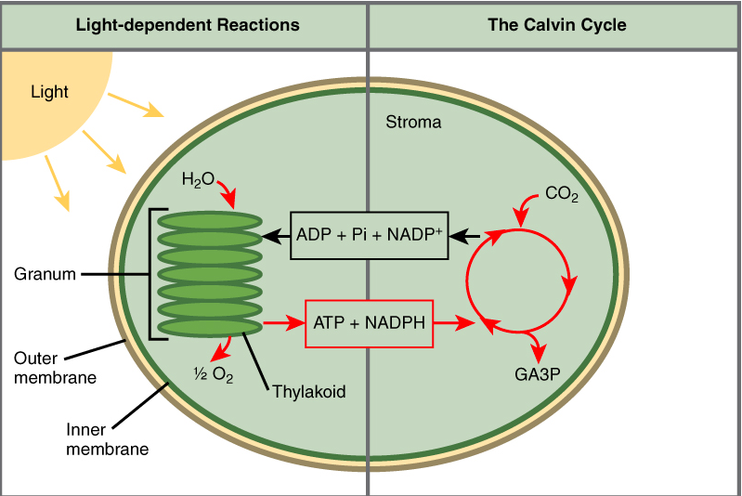
Light reactions and Calvin cycle
Photosynthesis takes place in two sequential stages: the light-dependent reactions and the light independent-reactions (Calvin cycle).
Just as the name implies, light-dependent reactions require sunlight.
In the light-dependent reactions, energy from sunlight is absorbed by chlorophyll and converted into stored chemical energy, in the form of the electron carrier molecule NADPH (nicotinamide adenine dinucleotide phosphate) and the energy currency molecule ATP (adenosine triphosphate).
The light-dependent reactions take place in the thylakoid membranes in the granum (stack of thylakoids), within the chloroplast.

Slide 33
Light-Independent Reactions
In the light-independent reactions or Calvin cycle, the energized electrons from the light-dependent reactions provide the energy to form carbohydrates from carbon dioxide molecules.
The light-independent reactions are sometimes called the Calvin cycle because of the cyclical nature of the process.
Although the light-independent reactions do not use light as a reactant (and as a result can take place at day or night), they require the products of the light-dependent reactions to function.
The light-independent molecules depend on the energy carrier molecules, ATP and NADPH, to drive the construction of new carbohydrate molecules.
After the energy is transferred, the energy carrier molecules return to the light-dependent reactions to obtain more energized electrons.
In addition, several enzymes of the light-independent reactions are activated by light.

Slide 34
Source–sink relationships in crops
Plants and some other microbes are autotrophs, i.e., they prepare their own food.
Therefore the process of self food preparation in plant is known as photosynthesis.
And the product is called photosynthate or photo-assimilate.
The source of production or manufacturing is called Source while storage or point of utilization is called Sink.
However, this food needs to be transported to different parts of the plant.
Phloem is a conducting tissue in plants that transports food to all the parts of a plant.
The movement of food from the source to the sink is known as phloem translocation.

Slide 35
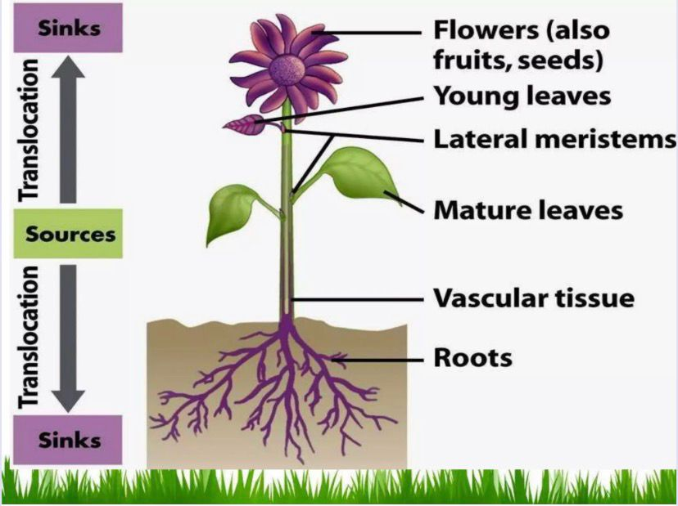
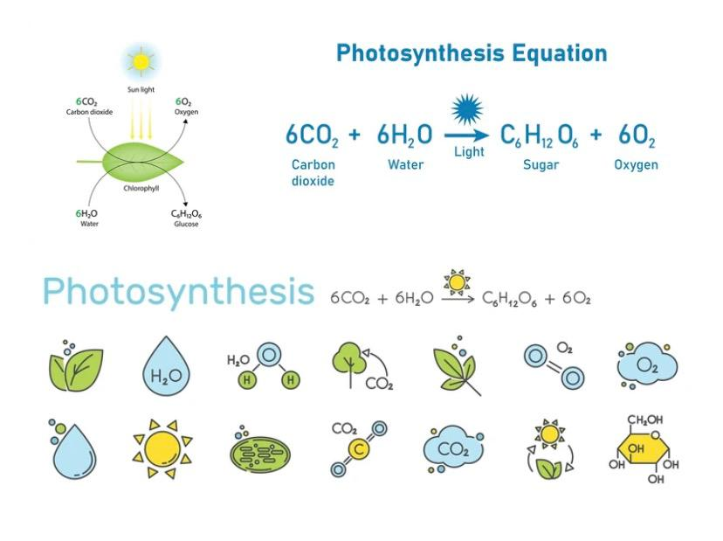

Slide 36
Definition of source and Sink
Source - The term source are referred to as the photosynthetically active parts of a plant.
Sources - include any exporting organs, typically mature leaves, that are capable of producing photosynthate in excess of their own needs.
SINKS - include any non-photosynthetic organs of the plant and organs that do not produce enough photosynthetic products to support their own growth or storage needs. Roots, tubers, developing fruits, and immature leaves, which must import carbohydrate for normal development, are all examples of sink tissues.

Slide 37
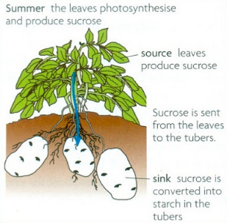
Source not always a source, and a sink is not always a sink
However, a source is not always a source, and a sink is not always a sink.
For example, leaves that act as sources when the plant is fully grown are known to act as sinks when the plant is growing

Slide 38
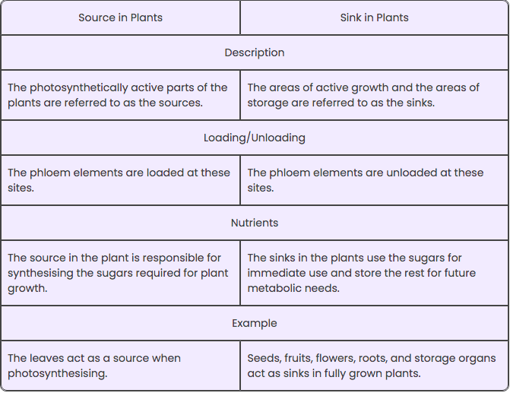
Differences between source and Sinks in plants

Slide 39
Net Assimilation Rate (NAR) and crop productivity
The Net Assimilation Rate (NAR) is a crucial physiological parameter that influences crop production by determining how efficiently a plant uses photosynthetic carbon to produce biomass. NAR is directly related to the plant's ability to convert light energy into dry matter, which is essential for growth and yield.

Slide 40
Crop Environmental Factors
Air: role of CO₂ and oxygen in crop growth
Light: intensity, quality, and duration (photoperiodism)
Moisture: rainfall, irrigation, and soil water availability
Temperature effects on germination, growth, and yield

Slide 41
Crop Environmental Factors
Crop environmental factors, which dictate growth, yield, and distribution, are divided into climatic, edaphic (soil), and biotic components.
Key elements include temperature, rainfall, light, and humidity. Soil factors like nutrient availability, pH, texture, and moisture are critical for plant development.
Optimal management requires understanding these interconnected abiotic and biotic factors.

Slide 42
Moisture: rainfall, irrigation, and soil water availability
The environmental factors influencing crop growth, including moisture, rainfall, irrigation, and soil water availability, are crucial for optimizing
agricultural production. These factors collectively determine the health and productivity of crops, as well as the sustainability of agricultural systems.
Here's a breakdown of how each factor impacts crop growth.
Moisture: Soil moisture is essential for plant growth, as it affects water availability for roots and overall plant health. Insufficient moisture can hinder nutrient uptake and photosynthesis, leading to reduced crop yields. Conversely, excessive moisture can lead to waterlogging and other issues.

Slide 43
Moisture: rainfall, irrigation, and soil water availability
Rainfall: Rainfall is a primary climatic factor influencing crop growth. Areas with high rainfall tend to have dense vegetation, while those with low rainfall experience limited natural vegetation. The amount and distribution of rainfall can significantly affect crop growth and yield.
Irrigation: Irrigation is necessary in areas with low rainfall or where natural vegetation is limited. It helps to ensure that crops receive the necessary water to thrive. However, it is essential to manage irrigation effectively to avoid water loss and ensure crop health.

Slide 44
Moisture: rainfall, irrigation, and soil water availability
Soil Water Availability: Soil water availability is determined by soil texture, structure, and organic matter content. Well-structured soils with stable aggregates allow for better infiltration and storage of water, reducing the risk of erosion and waterlogging.
Understanding and managing these factors is vital for sustainable agricultural practices and ensuring food security.

Slide 45
Air: role of CO₂ and oxygen in crop growth
Plants take in CO₂ through small cellular pores called stomata in the leaves during the day. During respiration (oxidation of stored sugars in plants producing energy and CO₂) plants take in oxygen (O₂) and give off CO₂, which complements photosynthesis when plants take in CO₂ and give off O₂. The CO₂ produced during respiration is always less than the amount of CO₂ taken in during photosynthesis. So, plants are always in a CO₂ deficient condition, which limits their potential growth.

Slide 46
Light: intensity, quality, and duration (photoperiodism)
Light (solar radiation) is crucial for plant growth because it is the primary source of energy for photosynthesis, the process by which plants convert light energy into chemical energy. Here are some reasons why light is important for plant growth:

Slide 47
Quality of Light
The quality of light refers to its spectral composition, which describes the distribution of wavelengths within the light spectrum.
In the visible spectrum (0.4 to 0.7 μm) approximately 85-90% light is absorbed, 5-10% is reflected, and 5% is transmitted by the canopies.
Plants have a high absorption rate for blue light (approximately 0.45-0.50 μm) and red light (approximately 0.65-0.70 μm), while they reflect green light.
Near infrared (NIR) (0.70 to 1.30 μm) re ection and transmission are much greater and low absorption than in visible range.

Slide 48
Quality of Light
If water is present on the surface of a leaf, wavelengths ranging from 1.3 μm to 2.9 μm tend to exhibit higher levels of absorption and lower levels of reflection and transmission.
Based on the information provided, it can be inferred that plants primarily rely on visible light especially blue and red light for their internal processes and is known as photosynthetically active radiation (PAR) spectrum.

Slide 49
Low Light Intensity
Light regulates numerous physiological and developmental processes through photoreceptors such as phytochromes, cryptochromes, and phototropins.
Insufficient light limits photosynthesis, reducing carbohydrate production needed for growth. Plants exposed to low light often exhibit etiolation - a phenomenon where stems elongate excessively while leaves become smaller and paler as the plant strives to reach a better light source.

Slide 50
Photosynthesis: Light intensity directly a ects the rate of photosynthesis in plants. As the intensity of light increases, the rate of photosynthesis generally increases until reaching a light saturation point. Beyond this point, further increases in light intensity may not significantly enhance photosynthesis. Different plant species have varying light intensity requirements for optimal photosynthetic activity.

Slide 51
2. Plant growth and morphology: Light intensity a ects plant growth and morphology.
Low light intensity can result in elongated, spindly growth and reduced leaf area.
High light intensity, on the other hand, can lead to stunted growth or damage due to excessive heat or radiation.
Different plant species have different tolerance ranges for light intensity, and it is important to provide an appropriate intensity level for each specific species.

Slide 52
3. Flowering and fruiting: Light intensity influences the timing and quality of flowering and fruiting in many plants.
Certain plants require specific light intensity thresholds or ratios to trigger or inhibit flowering.
Insufficient light intensity can result in delayed or reduced flowering, while excessively high intensity may negatively impact flower and fruit development.

Slide 53
3. Light adaptation and stress responses: Plants exhibit various adaptive responses to changes in light intensity.
They can adjust their photosynthetic machinery, pigment composition, and stomatal behaviour to optimize light absorption and minimize potential damage.
In response to high light intensity, plants may produce protective pigments, such as anthocyanins, or modify their leaf orientation to reduce light exposure.

Slide 54
Duration of Light
The duration of light refers to the length of time that plants are exposed to light within a 24-hour period, commonly known as the photoperiod.
The duration of light plays a crucial role in regulating various physiological and developmental processes in plants.
Here are some key aspects related to the duration of light:

Slide 55
1. Photoperiodic responses: Many plant species exhibit photoperiodic responses, which are specific physiological reactions triggered by the length of the light and dark periods.
These responses can include flowering, bud formation, dormancy, and other developmental changes.
Plants can be categorized as short-day plants, long-day plants, or day-neutral plants based on their speci c requirements for light duration.

Slide 56
2. Flowering induction: The duration of light is particularly important for regulating flowering in many plant species.
Short-day plants, also known as long-night plants, require a longer period of darkness than light to initiate flowering.
In contrast, long-day plants, also known as short-night plants, require a shorter period of darkness than light to induce flowering.
Day- neutral plants are not significantly influenced by the duration of light.

Slide 57
3. Vegetative growth and dormancy: The duration of light also influences vegetative growth and dormancy in plants.
Longer light durations can promote vegetative growth and inhibit the onset of dormancy, while shorter light durations can trigger dormancy and growth cessation.
The photoperiodic cues provide plants with information about seasonal changes and help regulate their growth patterns accordingly.

Slide 58
Temperature effects on germination, growth, and yield
Temperature is a critical environmental factor that significantly influences crop performance and growth. Here are some key aspects of how temperature affects crop performance:
Germination and seedling establishment - Temperature plays a vital role in seed germination and subsequent seedling establishment. Some seeds require cooler temperatures, while others need warmer conditions. The optimum temperature results in germination in the shortest time possible. In general, most of plants have a preferred temperature range for germination between 18°C to 29°C.

Slide 59
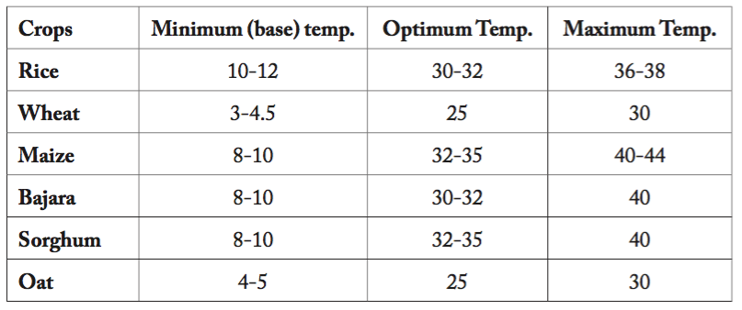
Requirement of cardinal temperature (°C) for certain crops

Slide 60
2. Growth and development - Temperature affects the rate of plant growth and development. Each crop has specific maximum and minimum temperature ranges that define the limits within which observable growth occurs. As temperatures increase towards the crops optimum level, vegetative development including the rate of node and leaf appearance, also increases. Generally, most plant species have a higher optimum temperature for vegetative development compared to reproductive development.

Slide 61
Biotic and Abiotic Factors
Biotic factors: pests, diseases, weeds
Abiotic factors: drought, salinity, frost, heat stress
Crop adaptation and stress tolerance mechanisms

Slide 62
Biotic and Abiotic Factors
Biotic factors in crop production are primarily caused by pests, diseases, and weeds. These factors can lead to significant reductions in crop yield and quality. Here's a brief overview of each:
Pests: These include insects such as aphids, caterpillars, and beetles, which can cause physical damage to crops and transmit diseases. Managing pests is crucial for maintaining crop health and productivity.

Slide 63

Diseases: Diseases caused by pathogens like bacteria, fungi, and viruses can devastate crops, leading to wilting, leaf spots, and decay. Effective disease management involves using appropriate treatments and preventive measures.

Slide 64
Weeds: Weeds compete with crops for nutrients, water, and sunlight, deteriorating the quality of harvested products. Control techniques include herbicides, cultural practices, and biological control.
By understanding and managing these biotic factors, farmers can enhance crop resilience and improve overall agricultural productivity

Slide 65
Plant Nutrients
Plant nutrients are essential chemical elements and compounds necessary for plant growth, reproduction, and metabolism. They are categorized into two main types:
Macronutrients: These include Nitrogen (N), Phosphorus (P), and Potassium (K), which are required in larger quantities for various functions such as protein synthesis and energy transfer.
Micronutrients: These include elements like Iron (Fe), Zinc (Zn), and Copper (Cu), which are needed in smaller amounts but are crucial for processes like enzyme function and chlorophyll production.
Overall, the availability of these nutrients directly affects plant health and productivity.

Slide 66
Essential vs beneficial nutrients
Essential nutrients are elements that plants must obtain from their environment to complete their life cycle. They are crucial for various physiological functions and are required in specific amounts. Essential nutrients are divided into macronutrients (needed in larger quantities) and micronutrients (needed in smaller quantities).
Beneficial nutrients are elements that, while not essential for plant survival, can enhance growth, development, and stress resistance when present in low concentrations.
Common beneficial nutrients include silicon (Si), sodium (Na), cobalt (Co), and selenium (Se). These elements can improve plant resilience against biotic and abiotic stresses, such as pests, diseases, and environmental conditions.

Slide 67
Criteria of essentiality (Arnon and Stout)
This concept was propounded by Arnon and Stout(1939) and they considered 16 elements essential for plant nutrition.
A plant cannot complete its life cycle in the absence of the elements.
The action of the elements must be specific, with no other elements being able to completely substitute for it.
The element must be shown to be directly involved in the nutrition of the plant.

Slide 68
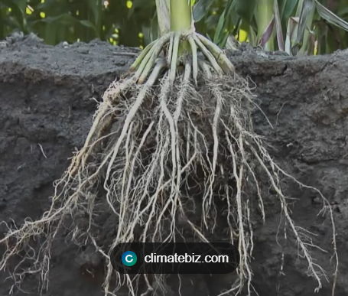
Plant Nutrient Uptake and Deficiencies
Plant nutrient uptake is a complex process that involves the movement of minerals and ions from the soil into plant roots and their subsequent transport to various parts of the plant. Nutrient deficiencies can lead to stunted growth, poor yield, or increased susceptibility to diseases. Understanding the mechanisms of nutrient uptake and the factors affecting absorption is crucial for agriculture, horticulture, environmental science, and sustainable land management.

Slide 69
Mechanisms of nutrient uptake by roots
Diffusion is the movement of ions or molecules from areas of higher concentration in the soil solution to lower concentration near the root surface. Nutrients with low mobility, such as phosphate ions, primarily rely on diffusion to reach the root for absorption.
Mass flow occurs when dissolved nutrients are carried along with water absorbed by roots. As plants transpire water through leaves, more water is drawn from the soil toward the roots, transporting soluble nutrients like nitrate, calcium, and magnesium.
Root Interception -As roots grow through the soil, they physically contact nutrient ions adsorbed onto soil particles or organic matter. This direct contact allows roots to absorb otherwise immobile nutrients.

Slide 70
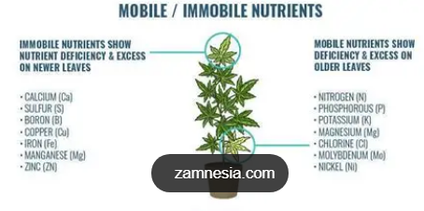
Mobile and non-mobile nutrients
Mobile nutrients can be translocated within the plant, allowing them to move to areas where they are needed most. Examples include nitrogen, phosphorus, and potassium. In contrast, immobile nutrients are fixed in the tissue where they are first deposited, and their deficiency symptoms appear in new growth. Examples of immobile nutrients include calcium, iron, and sulfur. Understanding the mobility of nutrients is crucial for diagnosing plant nutrient deficiencies and ensuring healthy plant growth.

Slide 71
Common plant nutrient deficiency symptoms
Nitrogen nutrition deficiency slows down the growth and development of plants.
Nitrogen deficiency symptoms in plants manifest in a distinct manner.
The plants appear stunted with light green lower leaves, while the upper leaves remain green, With prolonged Nitrogen nutrition deficiency, yellowing (chlorosis) of older or lower leaves occurs.
This is followed by leaf tip death and leaf margins developing a brown discoloration (necrosis). In some instances, the leaves fall off. The plant sterns become woody.

Slide 72
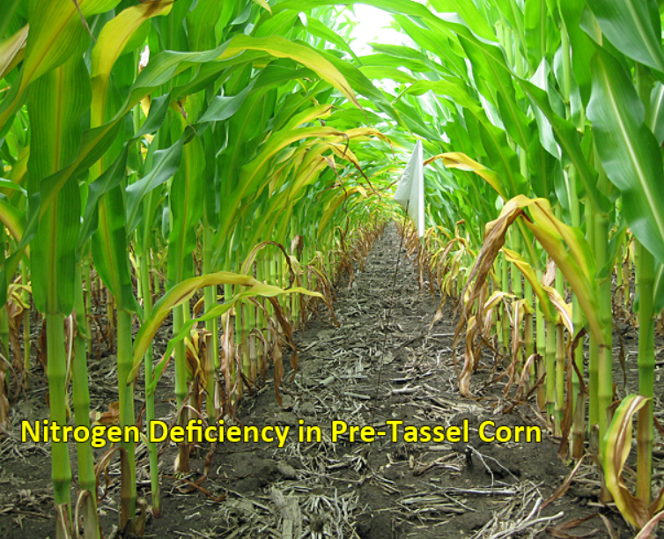
Nitrogen Deficiency in Maize

Slide 73
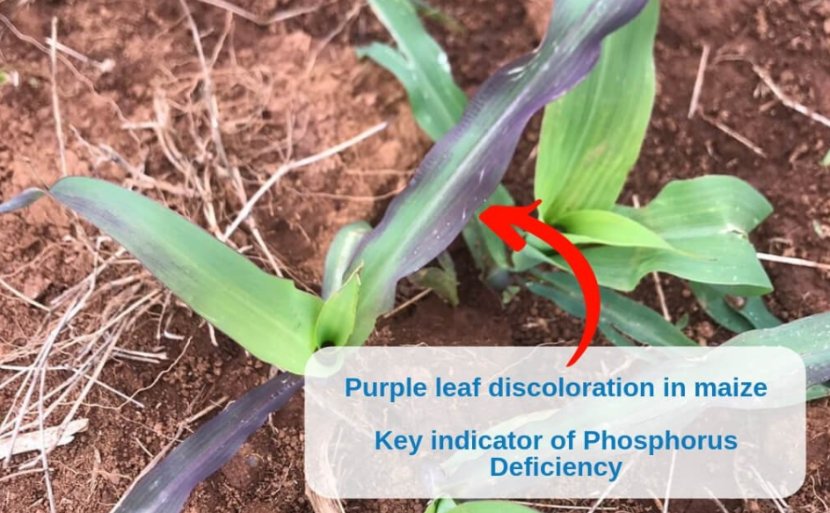
Phosphorus Deficiency in Maize
Nutrient Deficiency symptoms of Phosphorus in plants. Initially, plants with P nutrition deficiency appear darker green with reduced growth affecting the leaf size and stem thickness. As Phosphorus nutrition deficiency continues, the older, lower leaves develop irregular spots of brown to dark brown dead tissue. In some plants, reddish to purple pigmentation may appear on the under or upper surface of leaf margins, lower leaves, and stems. Eventually, leaf death of older leaves may occur.

Slide 74
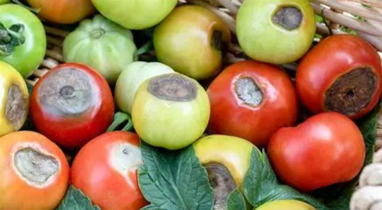
Calcium Deficiency in Tomatoes
Calcium is required for cell wall structure and cellular signaling. Calcium is important in cell division, cell expansion, building of cell walls, stomatal regulation, and cold tolerance.
Unlike other nutrients, calcium deficiency generally affects the growing points and young leaves of the plants. The young leaves are often twisted or wrinkled. In some cases, black spots appear on the growing points.
During fruiting lack Calcium nutrition can result in fruit cracking or in water-soaked tissues. Calcium deficiency in tomato plants normally results blossom end rot disease.

Slide 75
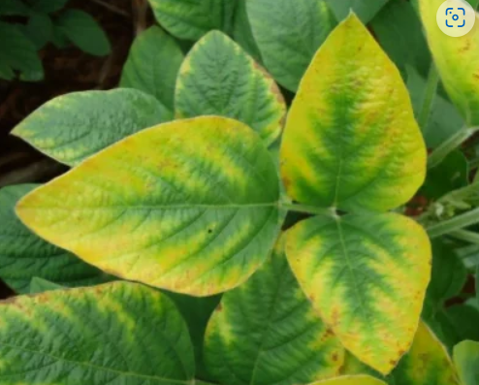
Potassium Deficiency in Soybean
Unlike nitrogen and phosphorus, potassium is not a component of plant organic matter. Potassium is important for movement of sugars, starch formation, pH stabilization, drought tolerance, cell turgor, enzyme activation, and regulation of stomata opening and closing.
The leaves of potassium deficient plants are small and dark green. The plants have short internodes resulting in a compact plant appearance. These symptoms are followed by a sudden development of irregular necrotic tissues along the leaf margins and tips of lower, older leaves and eventually covering whole leaves, making the leaves appear scorched.

Slide 76
Plant Hormones (Phytohormones)
Phytohormones are chemical compounds present in very low concentrations in plants.
They regulate plant development, growth, longevity and reproductive processes.
Here, let’s look at the structure and functions of different phytohormones like auxins, gibberellins, cytokinins, ethylene and abscisic acid.
They may act synergistically or individually. Roles of different hormones can be complementary or antagonistic.
Hormones play an important role in the processes like vernalisation, phototropism, seed germination, dormancy etc. along with extrinsic factors.
Synthetic plant hormones are exogenously applied for controlled crop production.

Slide 77
Growth-promoting hormones: auxins, gibberellins, cytokinins
Auxin - means “to grow”. They are widely used in agricultural and horticultural practices. They are found in growing apices of roots and stems and then migrate to other parts to act.
Natural: Indole-3-acetic acid (IAA), Indole butyric acid (IBA)
Synthetic: 2,4-D (2,4-Dichlorophenoxyacetic acid), NAA (Naphthalene acetic acid)

Slide 78
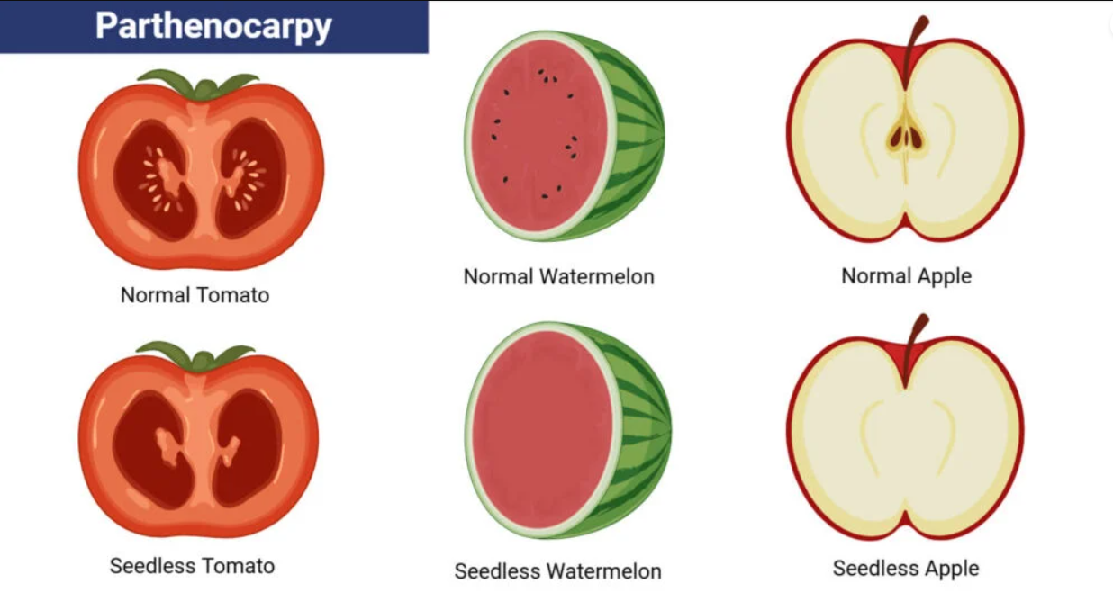
Functions of Auxin Hormone
Cell elongation of stems and roots.
Apical dominance, IAA in apical bud suppresses the growth of lateral buds.
Induces parthenocarpy i.e. development of fruit without fertilisation e.g. in tomatoes, cucumber, bananas and grapes.

Slide 79
Functions of Auxin Hormone
Prevents premature fall of leaves, flowers, fruits.
Useful in stem cuttings and grafting where it initiates rooting.
Promotes flowering e.g. in pineapple.
2,4-D is widely used as a herbicide to kill undesirable weeds of dicot plants without affecting monocot plants.
Helps in cell division and xylem differentiation.

Slide 80
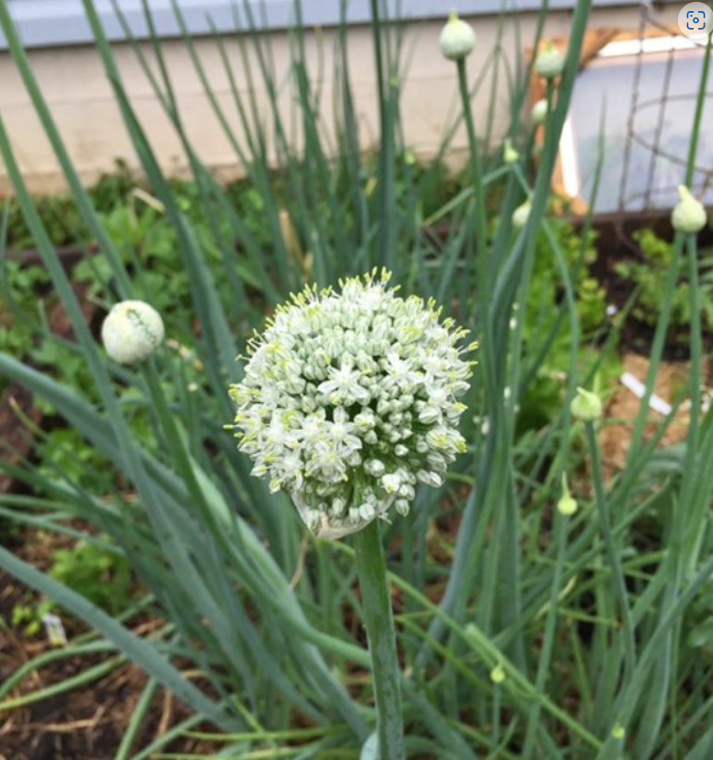
Gibberellins Hormone
They are plant growth regulators involved in regulating the growth and influencing different developmental processes like stem elongation, germination, flowering and enzyme induction etc.
Functions:
Promotes bolting, i.e. sudden elongation of internodes just before flowering in rosette plants like cabbage, beet.

Slide 81
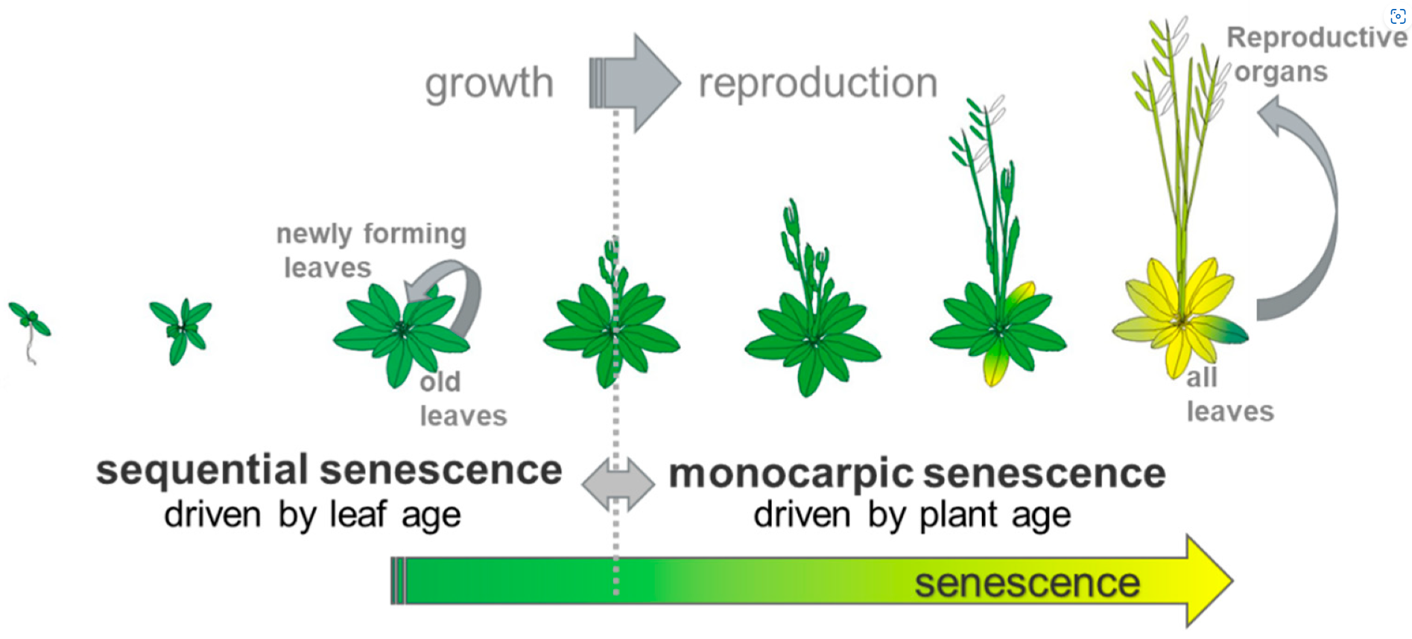
Gibberellins Hormone
Delays senescence.
Induces parthenocarpy.
Elongation of the stem and reverses dwarfism.
GA3 is produced from methylerythritol phosphate.
Induces the formation of hydrolytic enzymes such as lipase, amylase in the endosperm of germinating cereal grains and barley seeds.
Breaks seed dormancy.

Slide 82
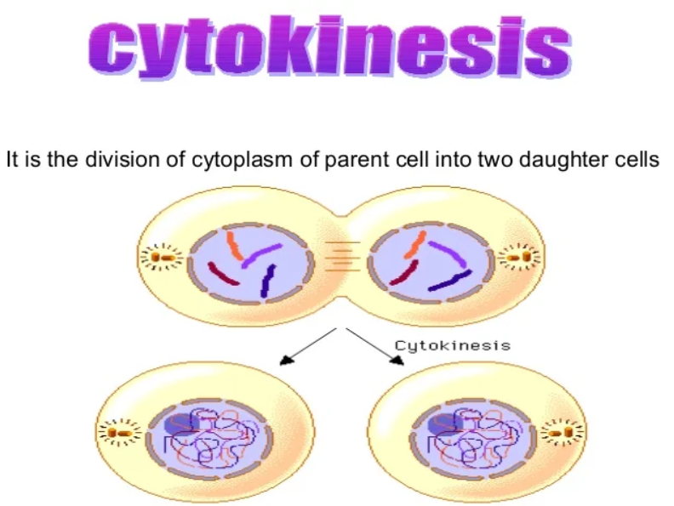
Cytokinins Hormone
Cytokinins play an important role in cytokinesis process.
They are primarily involved in performing cell division in plant roots and shoot system.
Cytokinins are naturally synthesised in the plants where rapid cell division occurs e.g. root apices, shoot buds, young fruits, etc. Movement of cytokinins is basipetal and polar.
Natural: Zeatin (corn kernels, coconut milk), isopentenyladenine
Synthetic: Kinetin, benzyladenine, diphenylurea, thidiazuron.

Slide 83
Functions:
It promotes lateral and adventitious shoot growth and used to initiate shoot growth in culture.
Helps in overcoming apical dominance induced by auxins.
Stimulate the formation of chloroplast in leaves.
Promotes nutrient mobilisation and delay leaf senescence.

Slide 84
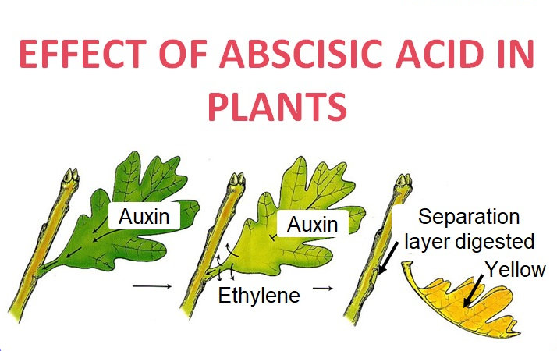
Growth-inhibiting hormones: abscisic acid, ethylene
Abscisic Acid - It is a growth-inhibiting hormone. ABAs act as an antagonist to GAs. It inhibits plant metabolism and regulates abscission and dormancy. It is also called “ stress hormone” as it increases the tolerance of plants.

Slide 85

Growth-inhibiting hormones: abscisic acid
Functions:
Induces abscission of leaves and fruits.
Inhibits seed germination.
Induces senescence in leaves.
Accelerates dormancy in seeds that is useful for storage purpose.
Stimulates closure of stomata to prevent transpiration under water stress.

Slide 86
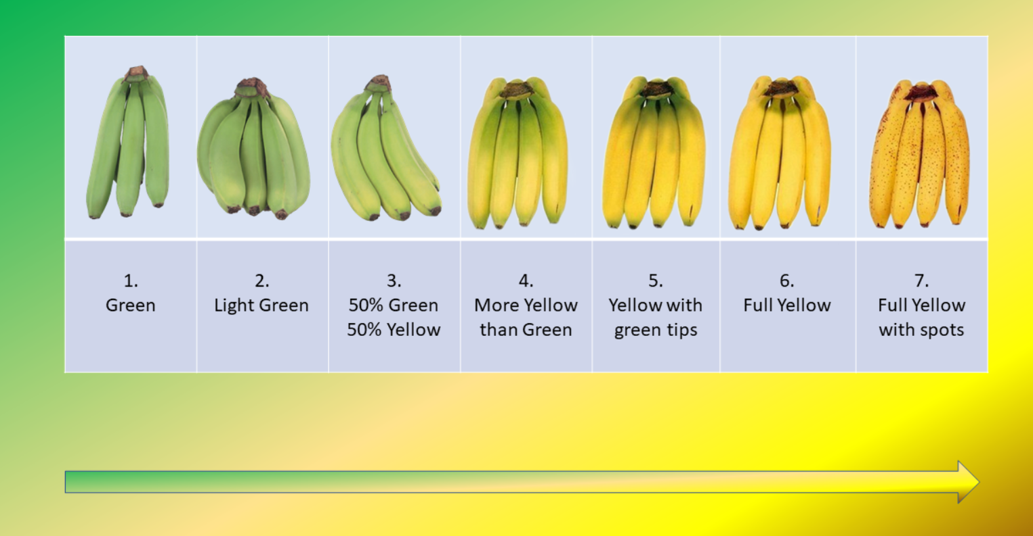
Ethylene Plant Hormone
Ethylene – is a group of plant growth regulators which are widely used for ripening fruits and for the production of more flowers and fruits. It acts as a growth promoter as well as an inhibitor. Occurs in gaseous form. It is synthesised in the ripening fruits and tissues undergoing senescence. It regulates many physiological processes and one of the most widely used hormones in agriculture.

Slide 87
Ethylene Plant Hormone
Functions:
It hastens the ripening of fruits.
Controls epinasty of leaves.
Breaks seed and bud dormancy.
Stimulates rapid elongation of petioles and internodes.
Promotes senescence and abscission of leaves and flowers.
Induces root growth and root hair formation thereby increasing the absorption surface.
Stimulates femaleness in monoecious plants.
Apical hook formation in dicot seedlings

Slide 88
Agricultural applications of plant hormones
Growth Promotion: Phytohormones like auxins, gibberellins, and cytokinins promote cell division, cell elongation, and differentiation. They are used to enhance the growth of crops and increase yield.
Weed Control: Synthetic auxins are used as herbicides. They cause uncontrolled growth in weeds, leading to their death.
Fruit Ripening: Ethylene is a phytohormone that promotes fruit ripening. It is used in the agriculture industry to control the ripening process of fruits during storage and transport.
Seed Germination: Gibberellins are used to break seed dormancy and promote germination, especially in crops like barley.

Slide 89
Agricultural applications of plant hormones
Rooting: Auxins are used to promote root formation in stem cuttings. This is particularly useful in plant propagation.
Delaying Senescence: Cytokinins help in delaying senescence (aging) in plants, thus extending their productivity.
Stress Tolerance: Some phytohormones like abscisic acid help plants to tolerate various stress conditions such as drought and salinity.
Flowering: Phytohormones like gibberellins and cytokinins are used to control flowering in plants.

